Slide 1
Croma Automation Framework
Innovative solutions to streamline automated processes
Notes:
AI-generated content may be incorrect. ---

Slide 2
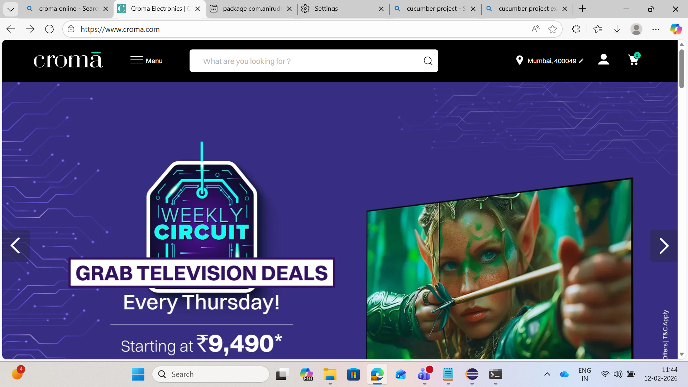
Project Overview
Notes:
Purpose and Workflow Summary

Slide 3

Purpose and Workflow Summary
Framework Setup and Data Input
The framework launches the home page and dynamically reads test data from Excel using Apache POI for data-driven testing.
Search and Filtering Process
Search terms are entered using CSS selectors; price range filters are applied via modal filter drawer with XPath selectors.
Product Extraction and Validation
Product names and prices are extracted with layered locators, parsed, and validated against test data price constraints.
Logging and Error Handling
Execution logs and screenshots on failure aid debugging, ensuring reliability and maintainability of the automation framework.
Notes:
This project focuses on crafting a robust end-to-end UI automation framework for validating e-commerce functionality on the Croma website using Selenium WebDriver, Java, and Cucumber BDD. The core workflow begins by launching the Croma home page, confirming the site’s readiness, and ensuring the search bar is interactable. Once the page loads, the framework reads test data dynamically from an Excel file using Apache POI, enabling data-driven validation. The user-entered search term—typically “laptop”—is typed into the global search bar by leveraging reliable CSS selectors based on attributes like data-testid and ID. After submitting the query, the browser navigates to the results page where product listings appear. The automation framework then proceeds to apply the Price Range filter using a modal-like filter drawer rather than traditional numeric input boxes, which modern e-commerce sites typically avoid. Interaction with this filter involves clicking the Price control, identifying the correct range label using text-based XPath selectors, and applying the appropriate checkbox option. The Apply button finalizes the filter, triggering the results section to refresh. This is validated using staleness checks on the first product card. The framework optionally attempts to sort items by popularity or relevancy using generalized XPath locators for sort-dropdown components. The next phase involves extracting the first product’s name and price using layered locator strategies that prioritize stable attributes such as product-title classes and price metadata tags. Through careful parsing of price strings and removal of special characters, the framework obtains numeric values ready for comparison. Finally, the extracted price is validated against the maximum price determined via test data or mapped price ranges, ensuring the product meets budget constraints. Logs are produced throughout the execution lifecycle to assist with debugging, and screenshots are captured on failure to aid post-test analysis. This approach results in a reliable, maintainable automation framework suited for retail product filtering and validation.

Slide 4
Technology Stack
Notes:
Tools, Libraries, and Technologies Used

Slide 5

Tools, Libraries, and Technologies Used
Core Programming Language
Java 17 provides strong type safety and seamless integration with WebDriver APIs for stable automation.
Browser Automation
Selenium WebDriver 4.x enables interaction with dynamic web elements across React-based interfaces.
Test Structuring and Execution
Cucumber BDD with Gherkin syntax and TestNG runner provide readable scenarios and parallel test execution.
Supporting Tools and Patterns
Page Object Model, Maven, Apache POI, Log4j2, and WebDriverManager enhance maintainability and data-driven testing.
Notes:
The automation framework behind this project is built upon a modern set of tools designed for stability, scalability, and maintainability. At the core lies Java 17, providing strong type safety, mature ecosystem support, and seamless integration with WebDriver APIs. Selenium WebDriver 4.x serves as the backbone for browser automation, allowing the framework to interact with web elements across dynamic pages rendered by Croma’s React-based, MUI-themed interface. To structure the test execution logically and ensure human-readable specifications, Cucumber BDD is employed, enabling the use of Gherkin syntax to define feature files and scenarios that closely mirror user journeys. TestNG is used as the runner due to its parallel execution capabilities, flexible test configuration, and enhanced reporting. Maven handles project dependencies, ensuring consistent versioning for Selenium, Cucumber, and Apache POI. The Page Object Model (POM) pattern organizes the automation logic, improving reusability and isolating DOM changes to specific classes. Apache POI enables reading external test data from Excel sheets, supporting data-driven testing and avoiding hardcoded parameters. Log4j2 is used to generate structured logs that capture detailed execution flows, including steps like search initiation, filter application, and validation results. WebDriverManager automatically resolves browser driver binaries, eliminating the need for manual driver setup. The framework also integrates JavaScript Executor for handling non-standard UI behavior and Selenium Actions for complex interactions such as clearing custom input fields or dealing with overlapping UI layers. This combination of technologies leads to a robust, maintainable, and scalable test automation system suitable for validating filtering, sorting, and search flows on e-commerce platforms.

Slide 6
Automation Workflow
Notes:
End-to-End Execution Flow of Test Scenario

Slide 7

End-to-End Execution Flow of Test Scenario
Configuration and Initialization
Workflow starts by loading base URL from a centralized config for environment flexibility and test setup.
User Interaction Simulation
Automated dismissal of overlays, search input interaction, and navigation simulate real user behavior reliably.
Dynamic UI Element Handling
XPath strategies detect UI elements for price filtering and sorting under varying screen sizes and formats.
Validation and Reporting
Price checks against budget and assertion logging ensure test accuracy and provide execution reports.
Notes:
The automation workflow follows a clearly defined sequence designed to imitate a real user’s behavior on the Croma website. First, the test opens the base URL retrieved from a centralized configuration file using the ConfigLoader utility class; this abstraction ensures environment flexibility. After the home page loads, any obtrusive overlays like cookie banners or modals are dismissed using targeted selectors to avoid interference with header elements. The search phase begins with locating the global search input through stable attributes such as data-testid and id, ensuring reliability despite dynamic class names. A clearing mechanism is applied to handle React-MUI input quirks, followed by entering the search term retrieved from Excel. Pressing Enter triggers navigation to the results page, where the automation waits for the product grid to appear or the URL to contain “/search”. The Price Range filter phase follows, handled by clicking the Price trigger that may appear as a button or accordion depending on screen size. The framework uses a multi-strategy XPath to detect the correct UI element. Upon clicking it, a modal or popover appears containing a list of checkbox-based price ranges. The desired range is selected using an XPath that normalizes text and handles Indian numbering format. After selection, an Apply button finalizes filtering, forcing the results list to refresh. Staleness-of-element checks ensure new results are loaded. The sorting step optionally attempts to click the Sort dropdown and choose relevant options like “Best Selling” or “Popular,” relying on generalized text-matching XPaths for flexibility. The framework then fetches the first product’s name by scanning known title selectors and retrieves the price by stripping non-numeric characters. Finally, it compares the product’s price against the max allowed budget derived either directly from Excel or via a price-range mapping method. Execution concludes with assertions verifying that the price falls within budget and logging results for reporting.

Slide 8
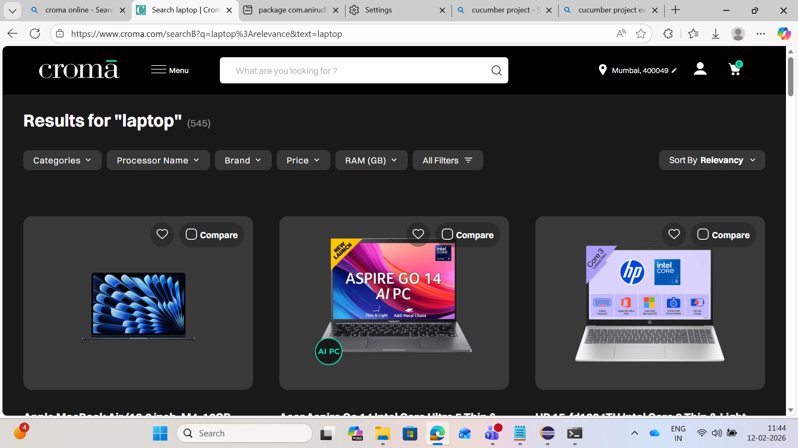
Important Locators and XPaths
Notes:
Critical Locators for Search, Price Filter, and Product Data

Slide 9

Critical Locators for Search, Price Filter, and Product Data
Search Field Locators
Reliable XPath targets data-testid attributes for direct access to dynamic search inputs on the homepage.
Price Filter Strategies
Multi-locator approach covers price button variations and case-insensitive label matching for price ranges.
Sorting and Apply Button
Text-based locators ensure stability for sorting options and the Apply button across UI states.
Product Title and Price Extraction
Combination of CSS and XPath locators extracts product titles and filters out invalid prices reliably.
Notes:
XPath and CSS locators play a crucial role in interacting with dynamic websites like Croma, especially given its MUI-driven component structure where classes frequently change. For the homepage search field, a reliable locator targets the container’s data-testid attribute, such as //*[@data-testid='search-list']//input[@id='searchV2'], ensuring direct access to the primary input element. Several fallback locators support edge cases, including checks for CSS classes like .search-field or version-tolerant patterns like id^='searchV'. The Price button on the results page exists in multiple UI states, so a multi-locator approach ensures coverage: //button[contains(.,'Price')] handles desktop button layouts, while //p[contains(.,'Price')]/ancestor::*[@role='button'] handles accordion-based triggers in responsive layouts. Transitioning to the price-range modal requires waiting for elements matching modal wrappers such as those containing MuiPaper-root or MuiPopover identifiers. The price range selection uses a robust, case-insensitive text-matching strategy on <label> elements because these encapsulate both checkbox inputs and visible range text. A sample locator is: //label[contains(translate(normalize-space(.),'ABCDEFGHIJKLMNOPQRSTUVWXYZ','abcdefghijklmnopqrstuvwxyz'),'60,001 - 70,000')]. This design avoids issues when item counts in parentheses change. The Apply button is consistently identified as //button[normalize-space()='Apply'], making it stable across UI modes. Sorting locators rely on textual detection for flexible matching, such as //button[contains(.,'Sort')] and options containing text like “best” or “popular.” Product title extraction combines CSS like a.product-title and XPath patterns searching for class names containing “product” and “title.” Price extraction uses flexible locators like span[data-testid*='price'] and filters out crossed-out prices using not(self::del). These carefully designed locator strategies ensure reliability across UI variants and dynamic layouts.

Slide 10
Framework Components
Notes:
Modular Structure of Page Object Model

Slide 11

Modular Structure of Page Object Model
BasePage Core Functions
Centralizes WebDriver management with reusable methods to prevent duplication across page classes.
HomePage Responsibilities
Manages landing page interactions including overlay dismissal, search bar handling, and navigation waits.
SearchResultsPage Handling
Manages post-search filtering, sorting, and data extraction with logic for responsive layouts and stale element detection.
Auxiliary Utilities
Includes DriverFactory for WebDriver lifecycle, ConfigLoader for configurations, and ExcelReader for test data.
Notes:
The framework’s implementation adheres to the Page Object Model (POM), emphasizing clean abstractions and maintainability. At its core lies BasePage, which centralizes WebDriver instance management and provides reusable methods such as waitVisible, waitClickable, exists, click, scrollIntoView, and JavaScript-backed interactions. This prevents duplication across page-specific classes. HomePage encapsulates functionality tied to the landing screen, including logic to dismiss overlays, locate the search bar through stable selectors, clear and populate input fields using hybrid keyboard and JavaScript approaches, and trigger search execution. It also incorporates explicit waits that confirm successful navigation to the results page. SearchResultsPage manages all post-search operations, including price range selection, sorting, product name extraction, and price parsing. Its price-range method employs a multi-locator approach to accommodate Croma’s dual responsive layouts (desktop filter bar and mobile modal). The class includes fallback logic to detect staleness after applying filters, ensuring that results are refreshed before any extraction. The framework also includes auxiliary utilities like DriverFactory for WebDriver lifecycle management, ensuring parallel safety and configuration-driven control; ConfigLoader for centralized configuration using properties files; and ExcelReader for fetching dynamic test data. Step Definition classes link Gherkin steps to Java operations, orchestrating search, filtering, validation, and reporting. This modular structure provides robustness, adaptability to UI changes, and easier scalability when adding new features or pages.

